Slide 1


ADAPT TRAINING Java Full Stack Development
ECE 501
Karampudi Jyothi Gangarsha
11701442
RE1701A003
E1701 / G1

Slide 2

Project analysis slide 2
Contents
Introduction of Company
Project Analysis - Backend
Training & Technological Stack
The PROJECT
Project Analysis - Frontend
Project Work Flow
Features
Project Block Model
Conclusion

Slide 3

Project analysis slide 2
Company
Vision: The business worth of innovation comes from and through individuals.
Mission: With you, we make and convey business and innovation arrangements that fit your requirements and drive the outcomes you need.
Founder: Serge Kampf
Founded: 1 Oct 1967, 54 years ago
Revenue: € 14.2 billion (2019)
CEO: Aiman Ezzat
CEO India: Srinivas Kandula

Slide 4
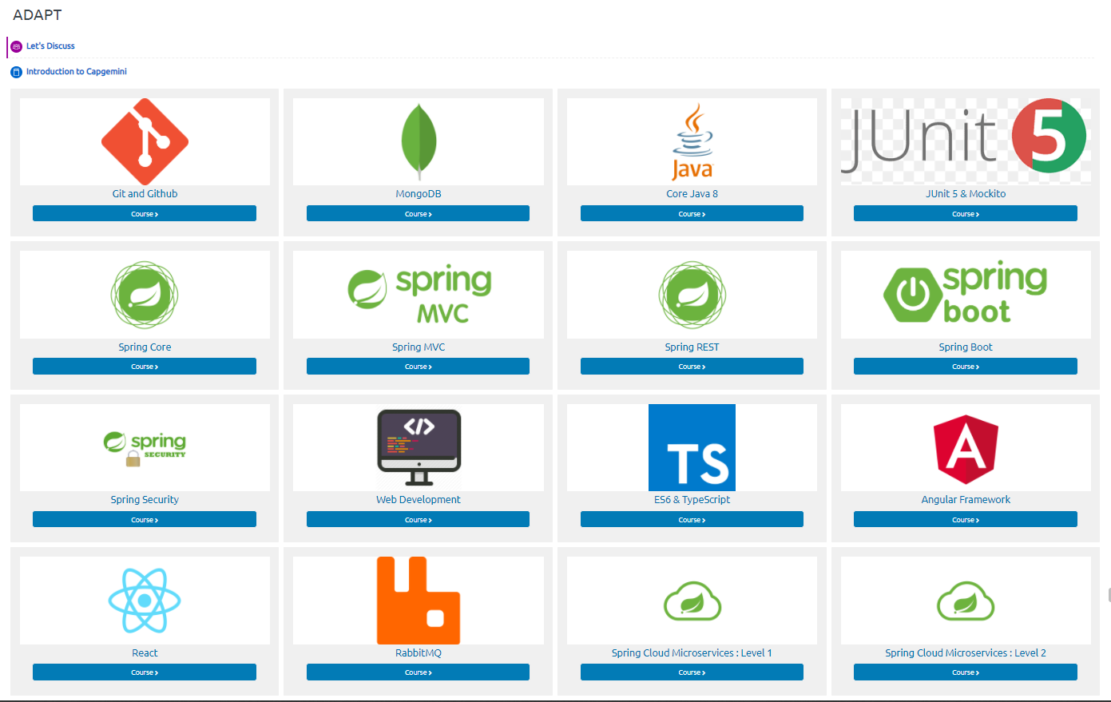
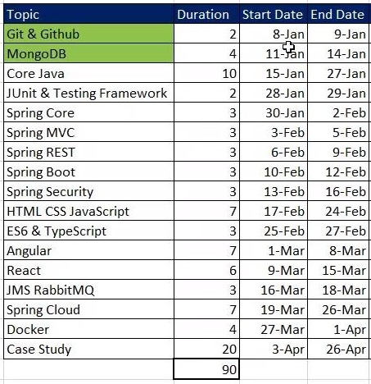
Project analysis slide 2
Training
ADAPT is a self-pace learning platform. Our training program has 2 parts:
Learning
Project ( case study )

Slide 5










Project analysis slide 3
Technological stack
Git & GitHub
Mongo DB
Core Java
Spring
Web Development
Angular
React
JMS
Junit
ES6 & Typescript

Slide 6
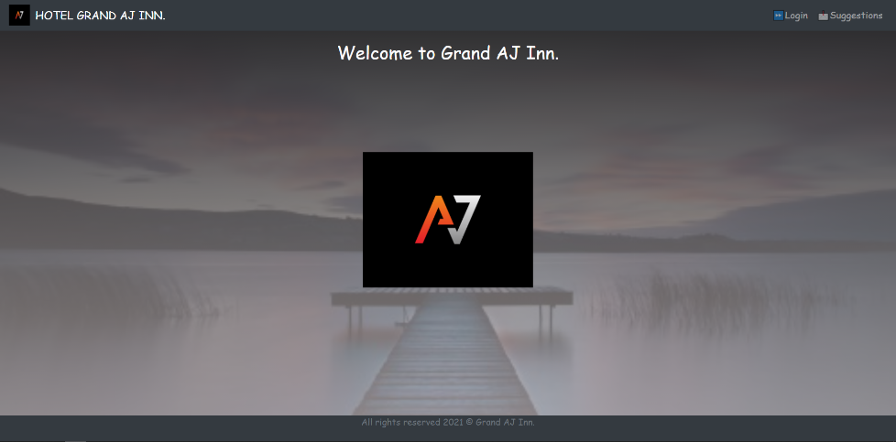
Project analysis slide 3
The Project
Online Hotel Management System
The objective is to build a Fully Functional Java Full Stack Web Application from Scratch using learnt technologies which lets entire operations of a hotel to integrate online.
Hotel Grand AJ Inn.
Owner Functionalities:
Manage Departments (Add, Edit, Delete)
Manager Functionalities:
Manage Room Details (Add, Update, Delete, Set Rates)
Manage Staff (Add, Update, Delete, View)
Manage Inventory (Add, Edit, Delete)
Staff Functionalities:
Manage Guest (Add, Update Guest)
Search Room availability
Add Payment, Issue Bills

Slide 7
Project analysis slide 4
Project Work-Flow
Payment Gateway
PayPal payment gateway is integrated.
Developed all spring boot applications that would act as micro-services.
Spring Boot Applications
Authentication using nodeJs for better security at front end.
Eureka,
API-Gateway
React App
Authentication node
Integrated mongo Database with spring applications
Eureka client is to discover all services running and for rest API Calls. API- Gateway to centralize all API calls through single port.
Mongo Database
Web application is build in react.
testing
UI and Backend testing is done.
Backend
Middleware
Frontend

Slide 8
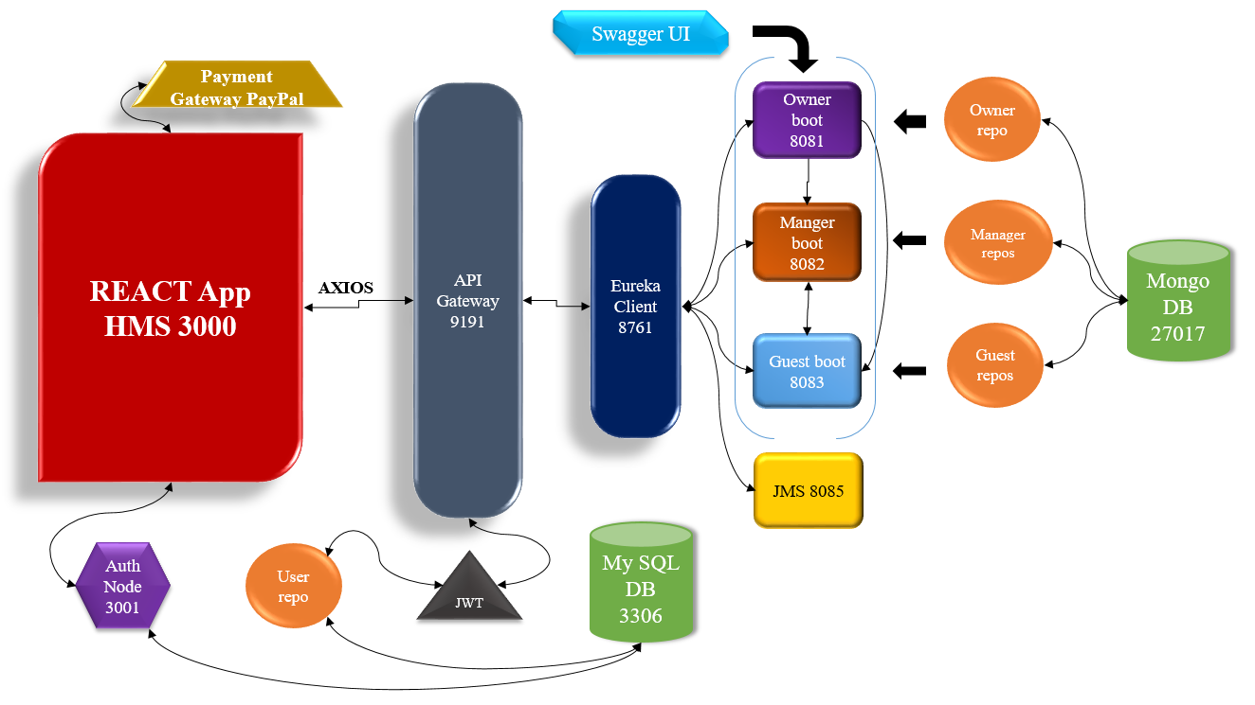
Project analysis slide 3
Project Block Model

Slide 9
Project analysis slide 6
Project Analysis
Back-end
Deals with owner operations, CRUD of department. Runs on port 8081. Access to only owner.
Deals with manager operations, CRUD of Room, Staff, Inventory.
Runs on port 8082. Access: Owner, Manager.
Deals with guest operations, guest check-in, check-out, payment. Runs on port 8083. Access: Owner, Manager, Staff.
Mongo DB
My SQL DB
Used as main data base for storing all Json format data into collections coming from different spring applications.
Owner Boot
Manager Boot
Guest Boot
Used as partial data base for storing all user credentials data into table and retrieving them during authentication.
JMS
Eureka
API Gateway
Deals with suggestions handling via JMS, messaging queue, sending and receiving. Runs on port 8085.
Is a Discovery client, discovers all services running & Enables Rest Calls (Internal Micro-service communication). Runs on port 8761.
To centralize all API calls through single port address, can enable spring security through this service. Runs on port 9191.

Slide 10
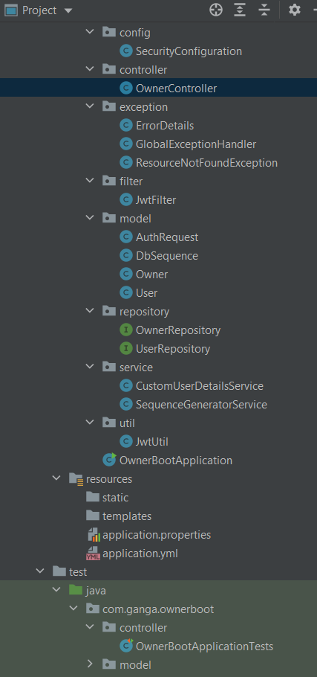
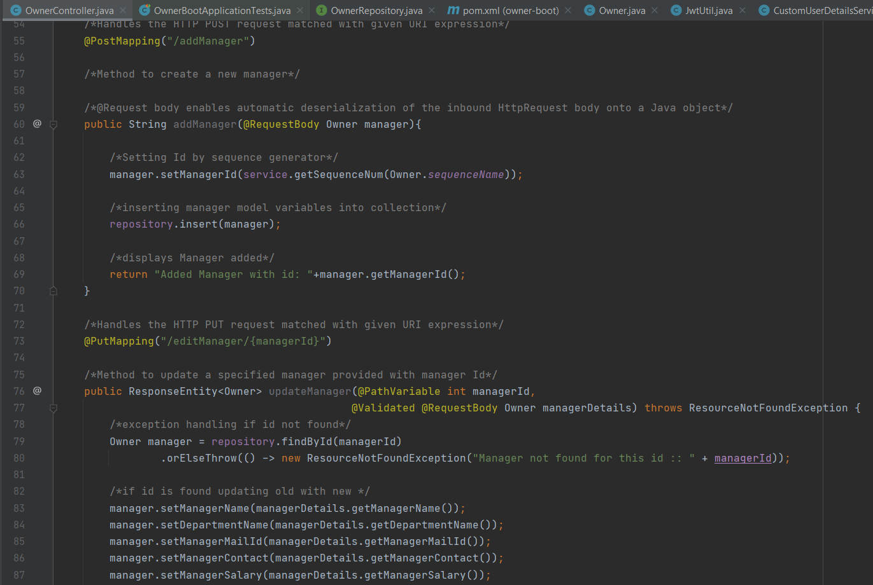
Project analysis slide 6
Project Analysis
Back-end
Controller

Slide 11
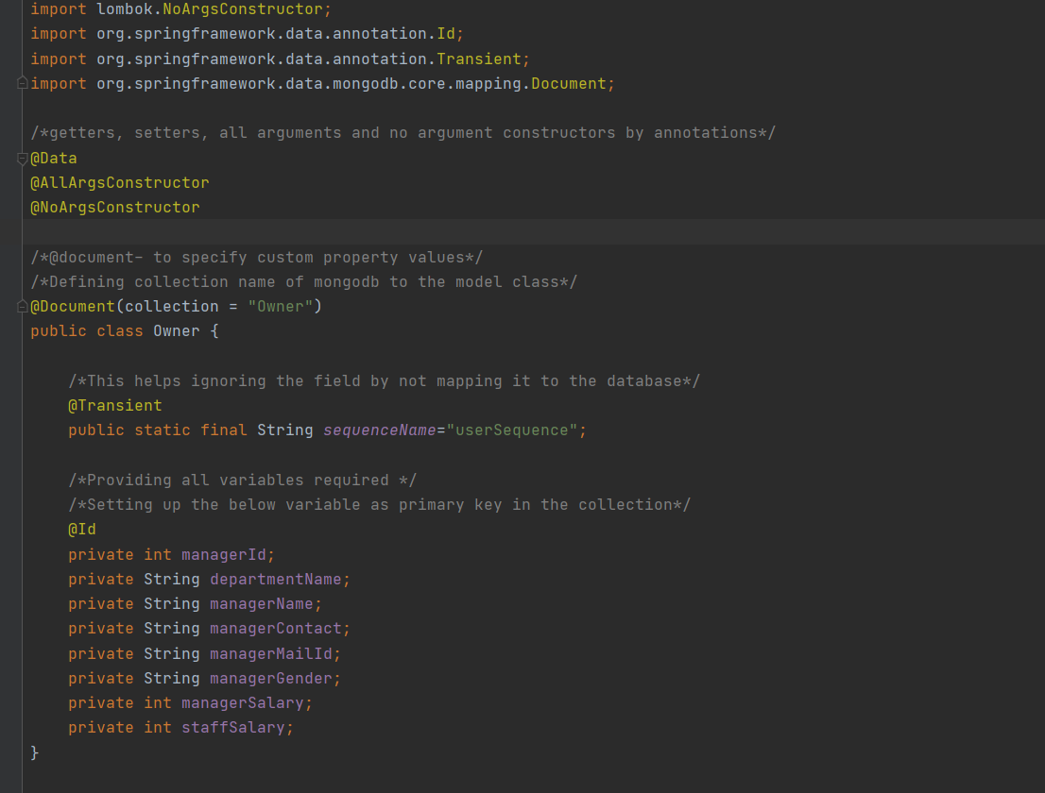
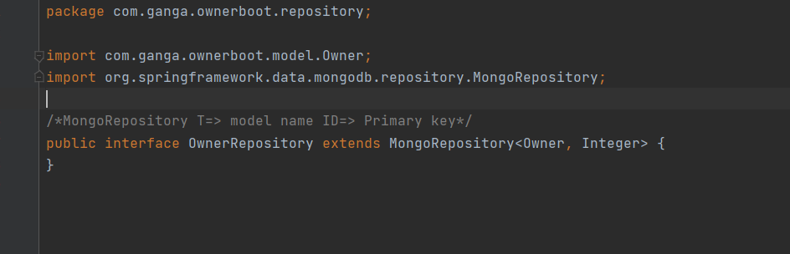
Project analysis slide 6
Project Analysis
Back-end
Owner Repository
Owner Model

Slide 12
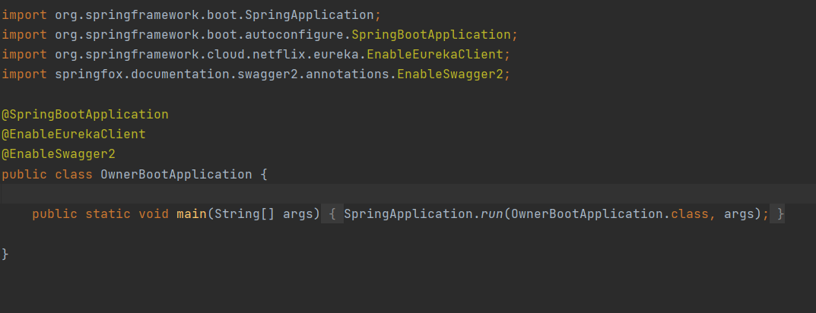
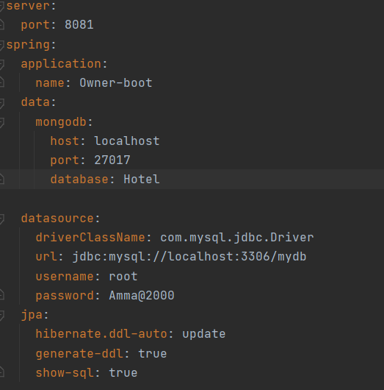
Project analysis slide 6
Project Analysis
Back-end
Owner-Boot Main class
Application.yaml

Slide 13
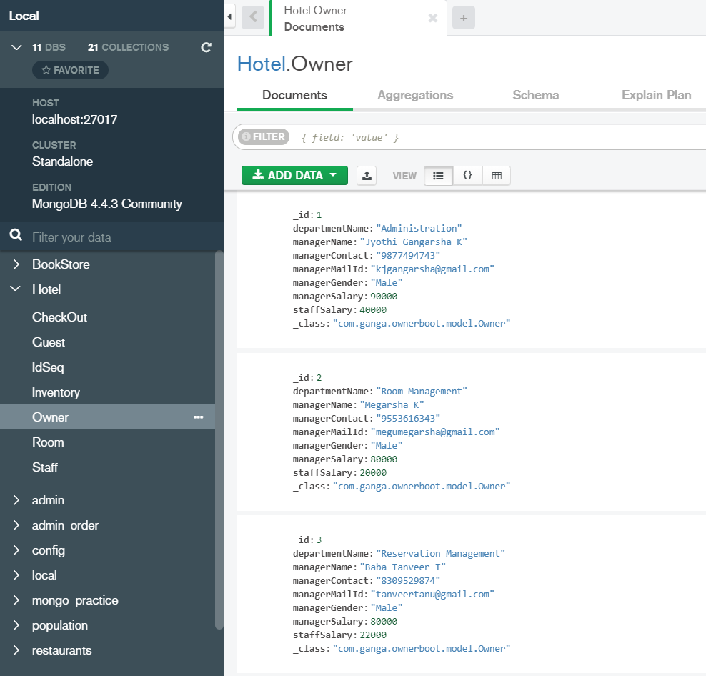
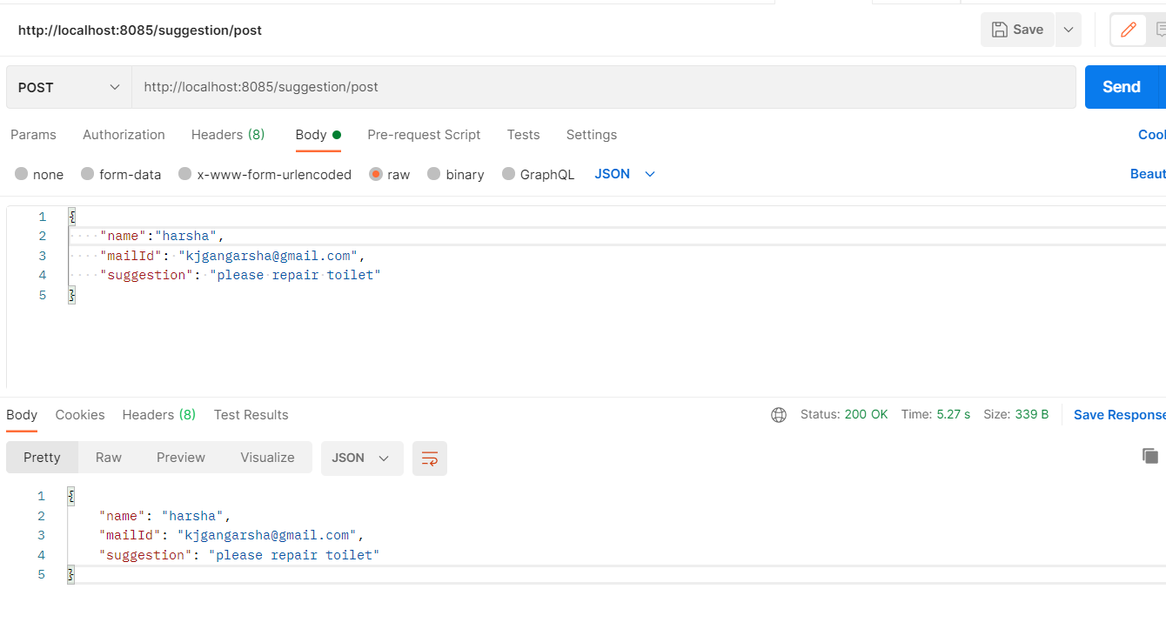
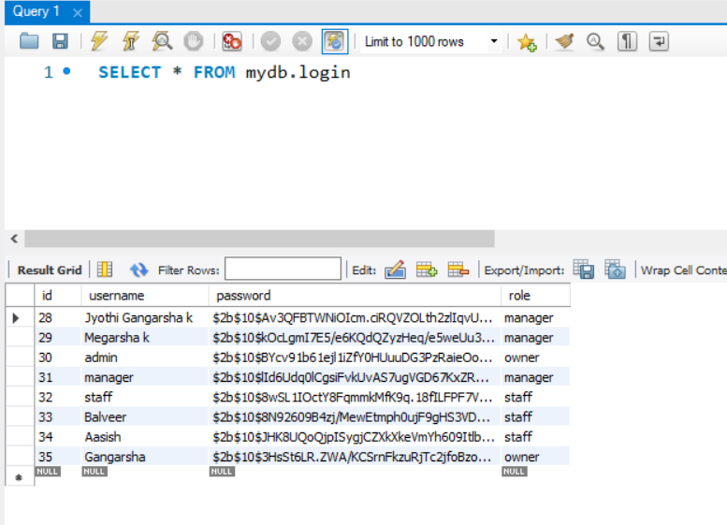
Project analysis slide 6
Project Analysis
Back-end
Postman
Mongo DB Compass
My SQL

Slide 14
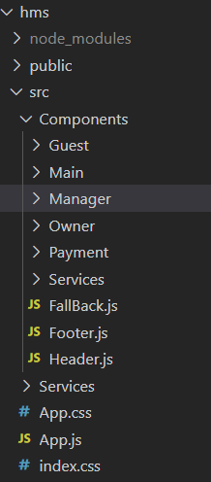
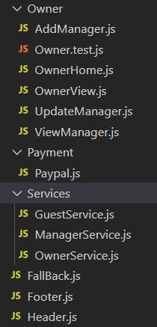
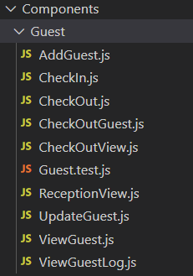
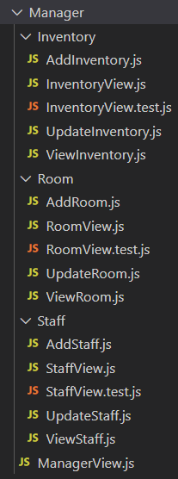
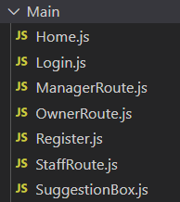
Project analysis slide 6
Project Analysis
Front-end
Guest .Js files
React Components
Owner, PayPal, Services .Js files
Manager .Js files
Main .js files

Slide 15
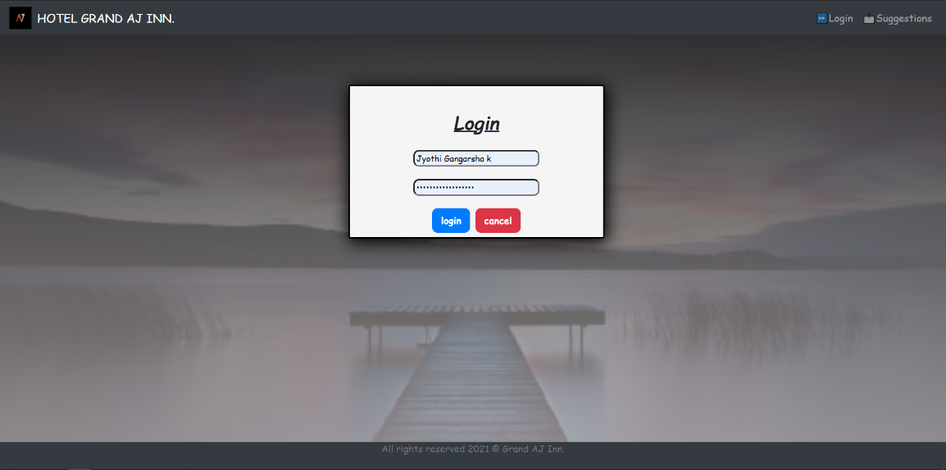
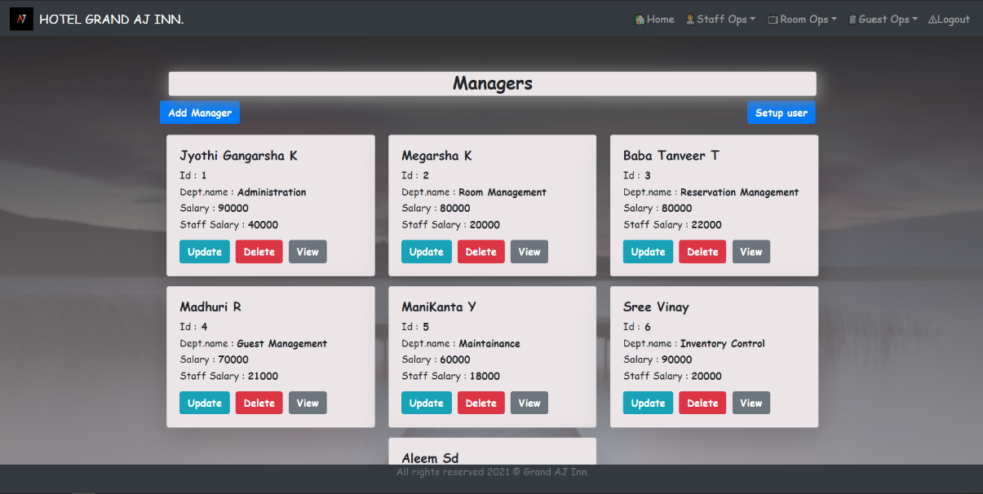
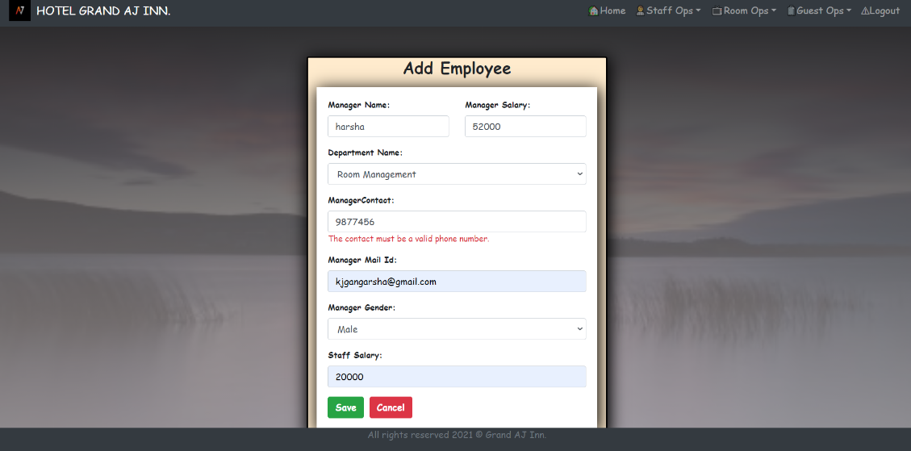
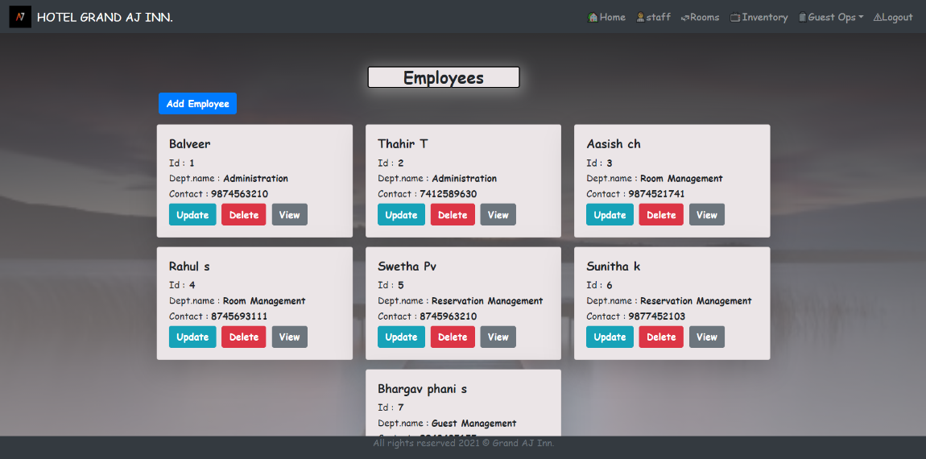
Project analysis slide 6
Project Analysis
User Interface
Login page
Owner page
Add Employee form
Manager page

Slide 16
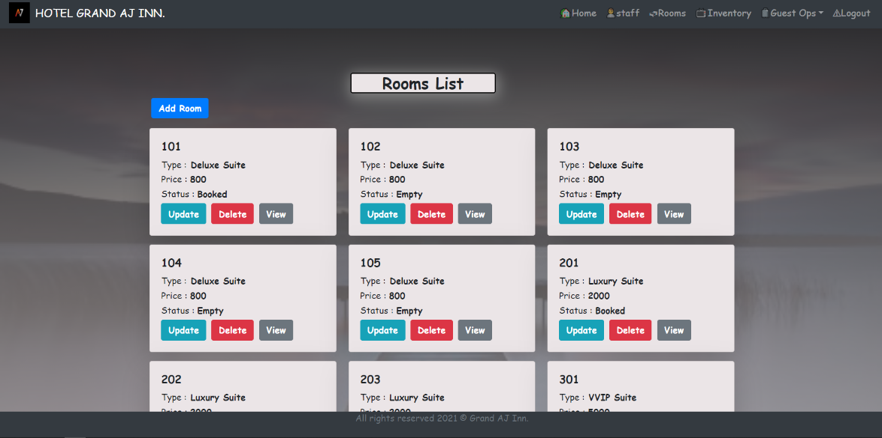
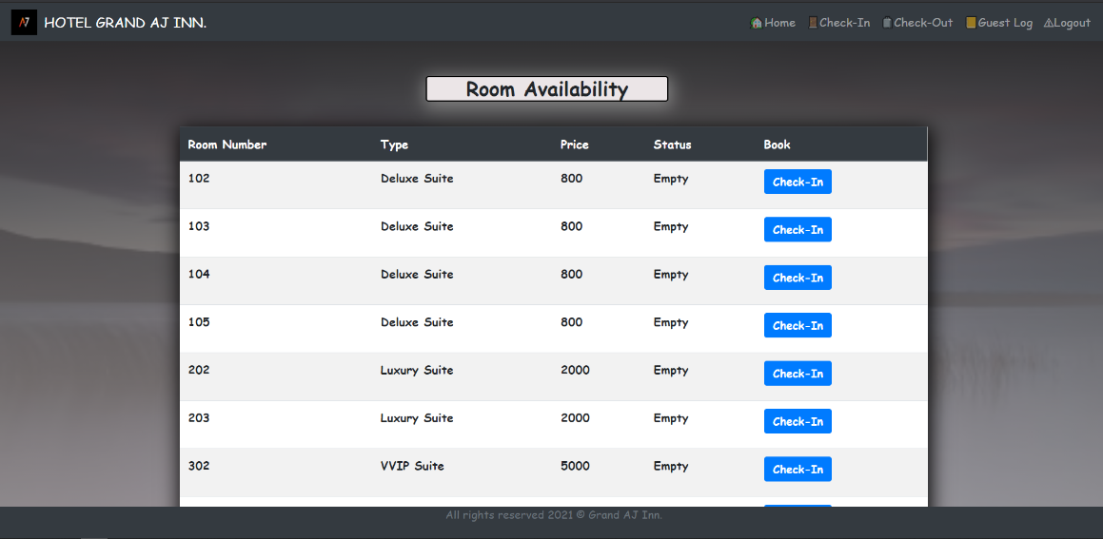
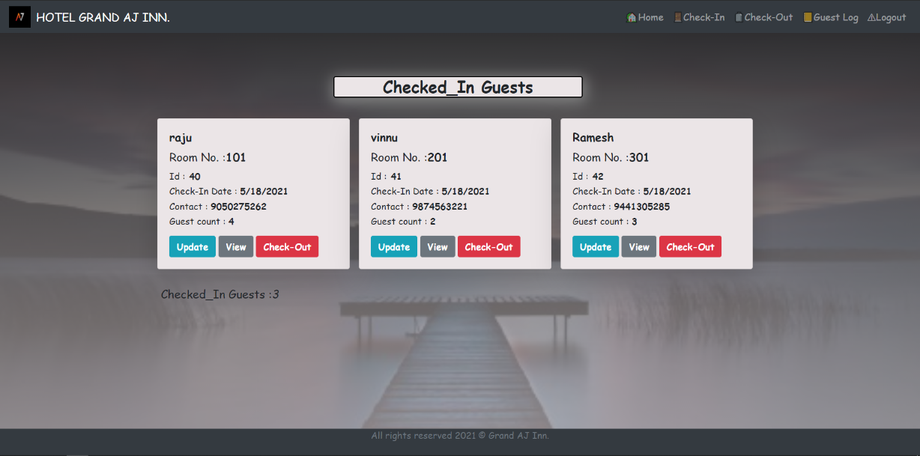
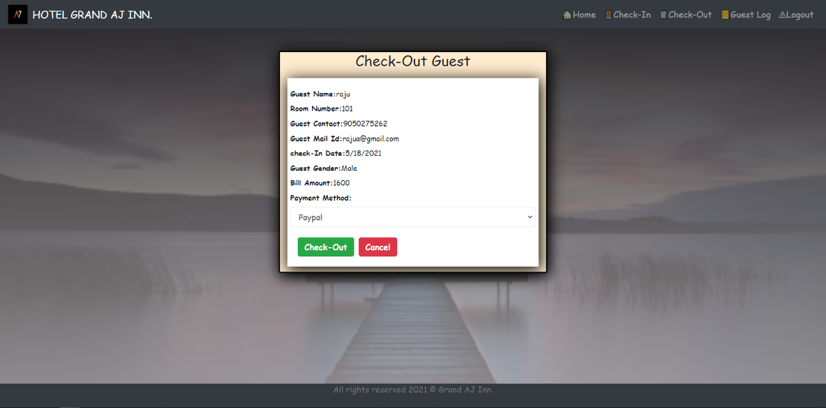
Project analysis slide 6
Project Analysis
User Interface
Rooms List
Room Availability
Checked-In guests
Check-out guest

Slide 17
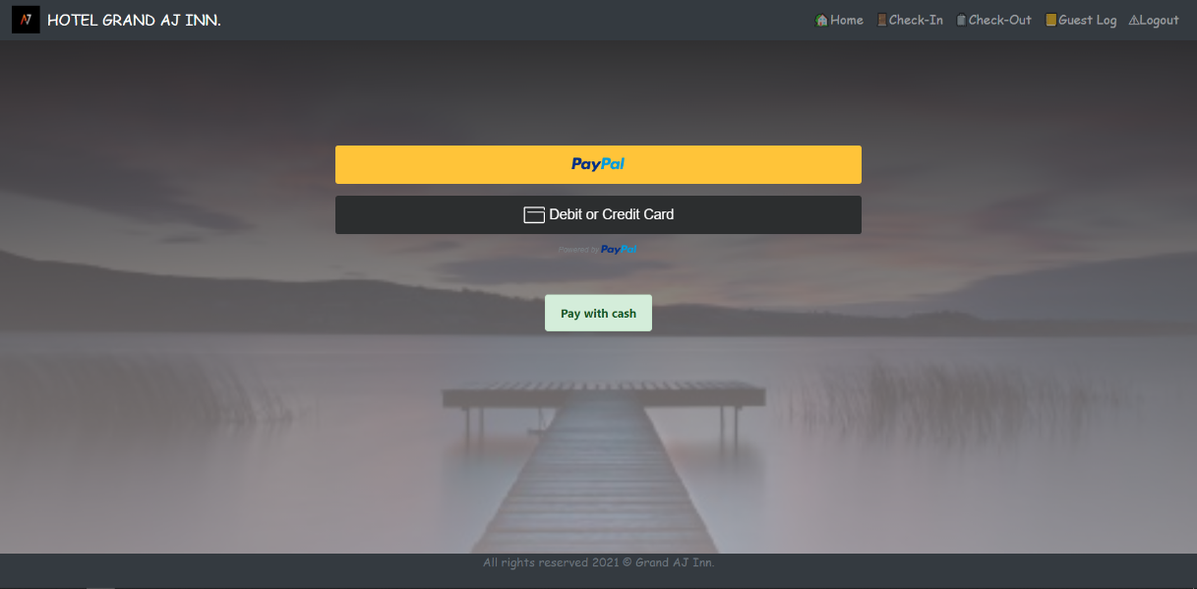
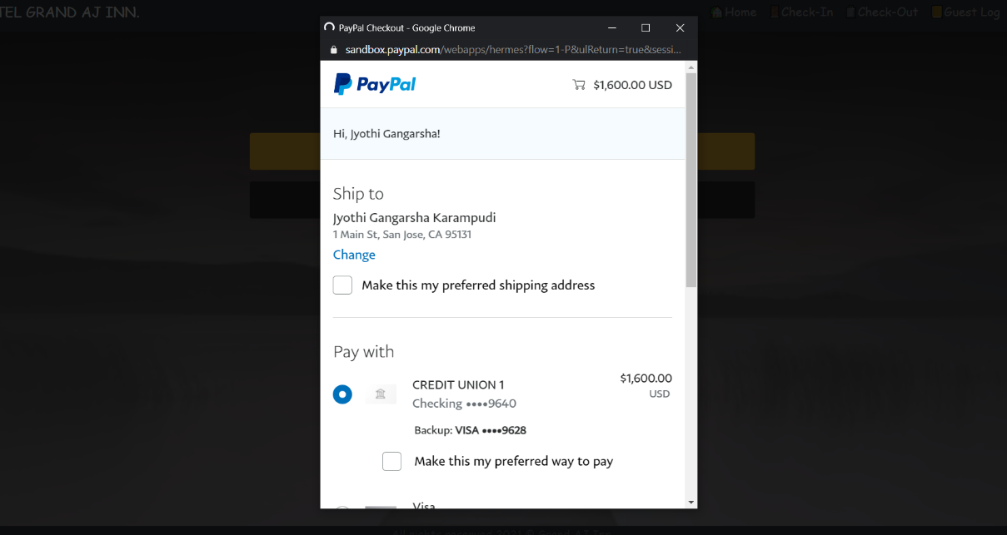
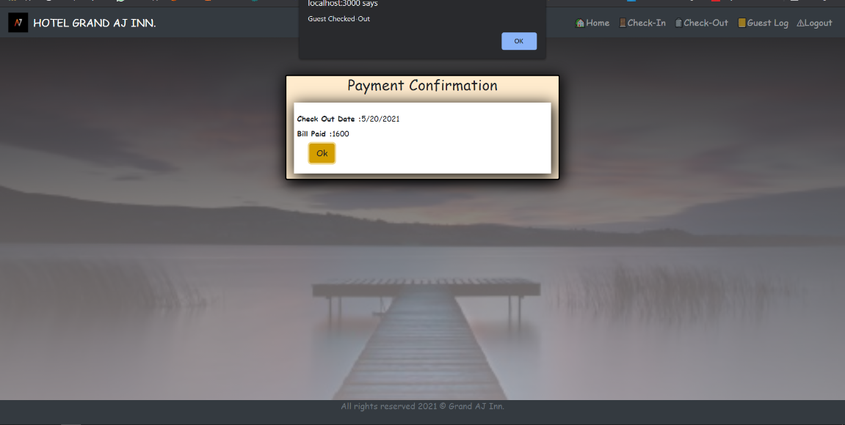
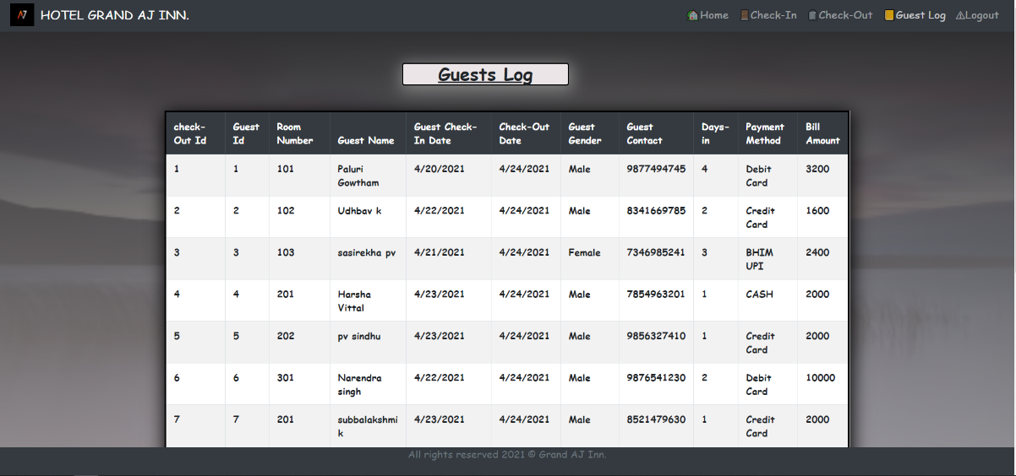
Project analysis slide 6
Project Analysis
User Interface
PayPal
Payment process
Payment confirmation
Guest log

Slide 18
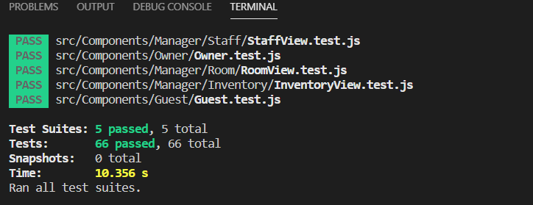
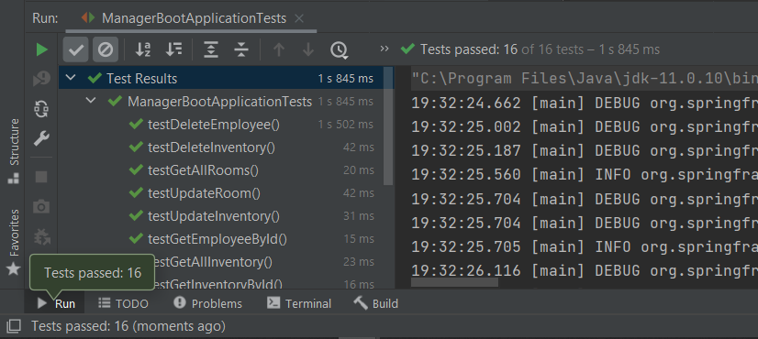
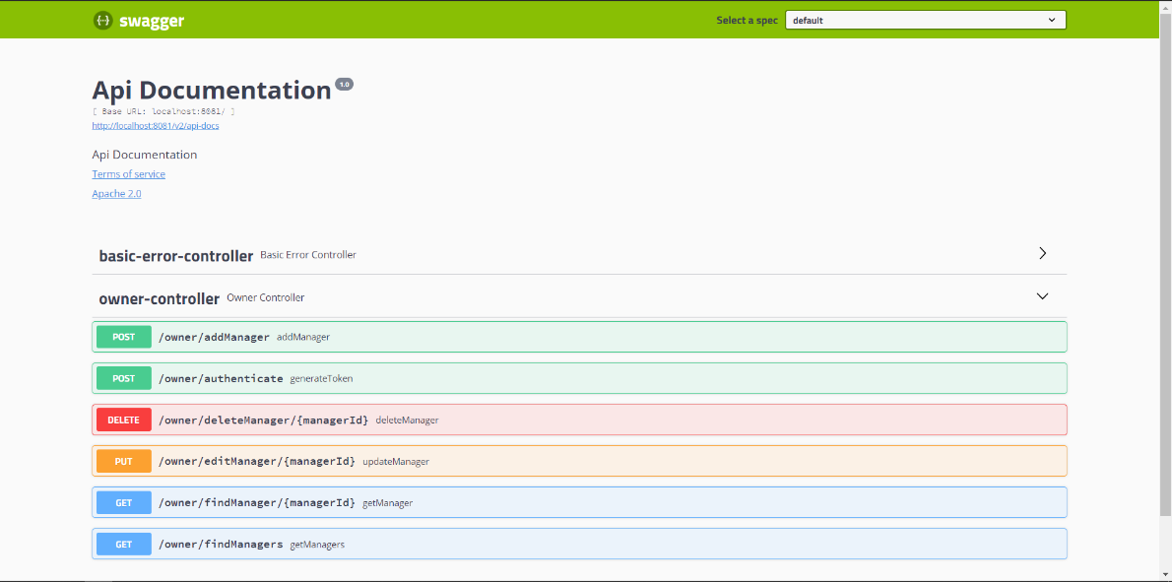
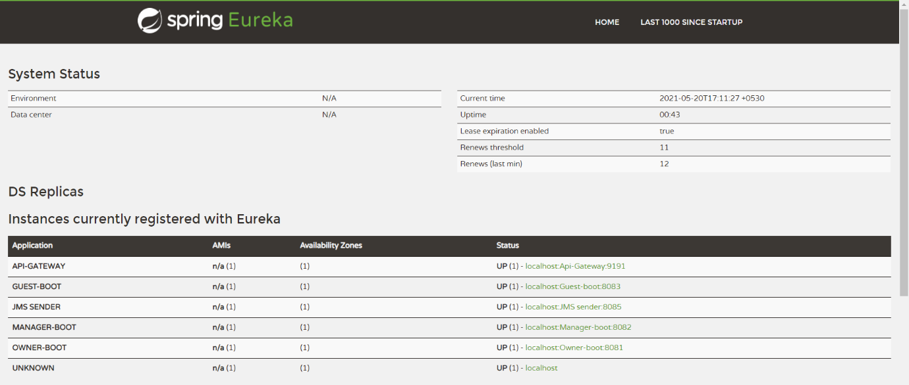
Project analysis slide 6
Features
UI testing
Backend Testing
Swagger UI
Eureka Client

Slide 19
Project analysis slide 6
Conclusion
Further Development
Configure Rabbit Mq to send bill as e-mail and message notifications to guest.
Implementation of project in AWS.
This training helped me to excel in a huge bundle of technological stack and to implement them practically. From scratch to a Java full stack developed web application, although faced many challenges but I walked through my first step of achievement in my career path.

Slide 20
Thank You

